Slide 1
Bowtie Presentation
Approach 2
GROUP 1: Laasya Venugopal, Natalia Walker, Sandra Gyamfuaa Badu, Harshavardhan Chinthapatla, Kanniese Chen

Slide 2
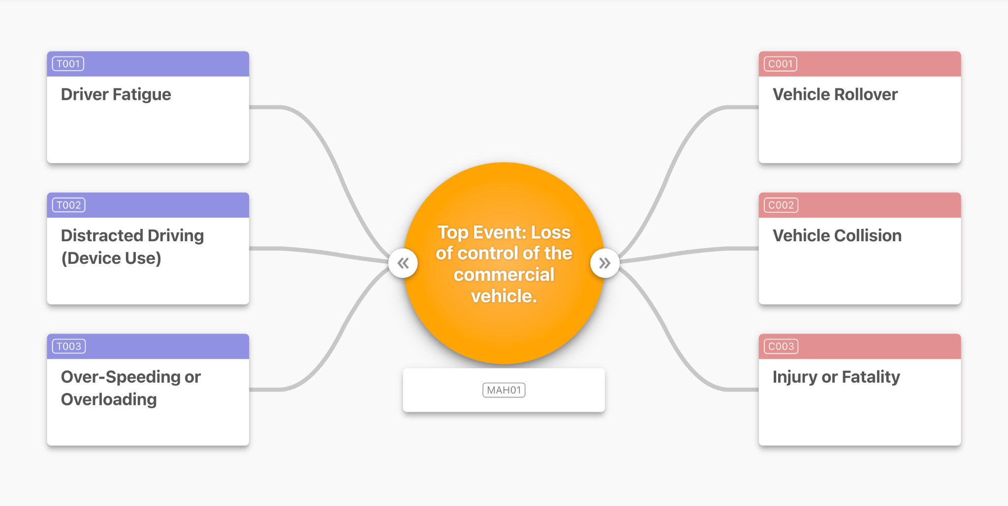
LIVE DEMO (PRESIGHT - OPENRISK)
Notes:
https://openrisk.presight.com/bowtie/2663260490/1094/embed

Slide 3
Understanding Risk Through Bowtie Visualization
Purpose
To clearly communicate how loss of control in commercial vehicles can occur, and how safety controls reduce both the likelihood and severity of harm.
Our Bowtie method help:
Visualize causes, controls, and consequences in one diagram
Simplify complex risk information for diverse audiences
Identify where prevention and mitigation efforts have the most impact

Slide 4

DESIGN CHOICES: Prototype Logic & Trade Offs
1
2
3
4
5
Color Scheme
Trade-Offs
Barrier Attribute Bars
Click-To- Expand
Expanding / Collapsing
Assigned distinct colors to hazards, barriers, and consequences so viewers can instantly recognize each element using pre-attentive visual cues
Used interactive expansion to give users control over how much detail they want to view at any moment.
We used Presight’s hover, click-to-expand, and barrier failure toggles to let users explore how risk changes in real time.
A clean, well-spaced layout helps the audience follow the risk story quickly while avoiding clutter and keeping the diagram clear.
Added small color-coded attribute bars under each barrier to show type, robustness, and criticality in a compact, readable format.

Slide 5
Lessons Learned
Date
1
2
3
4
Visual Hierarchy Guides Attention
Clear Structure Improves Understanding
Color Coding Enhances Interpretation
Simplicity Supports Better Decision-Making
Using the bowtie format helped simplify a complex risk problem. The left-to-right flow made it easy to see threats, controls, and consequences in one view.
Applying consistent colors for “Good,” “Fair,” and “High” performance helped the audience quickly compare barriers and understand their effectiveness.
Placing the top event at the center and arranging barriers around it helped viewers follow the logic without confusion and focus on what matters most.
Breaking down the risk into smaller, labeled components made the story clearer and supported faster discussion, especially for non-technical audiences.

Slide 6
Key takeaways
1
2
3
4
Clear Labeling Improves Audience Comprehension
Color Coding Strengthens Storytelling
Visual Structure Supports Better Decision-Making
Make Complex Risks Easy to Understand
Clear labels (Threats, Controls, Consequences) and consistent formatting made the diagram understandable even for non-experts.
Bowtie diagrams turned a complex vehicle-safety problem into a clear, easy-to-follow structure.
Color-coded control cards quickly showed barrier type and strength, making the visuals more intuitive.
The left-to-right bowtie layout displayed the entire risk landscape at once, supporting quick decisions and revealing improvement gaps.

Slide 7
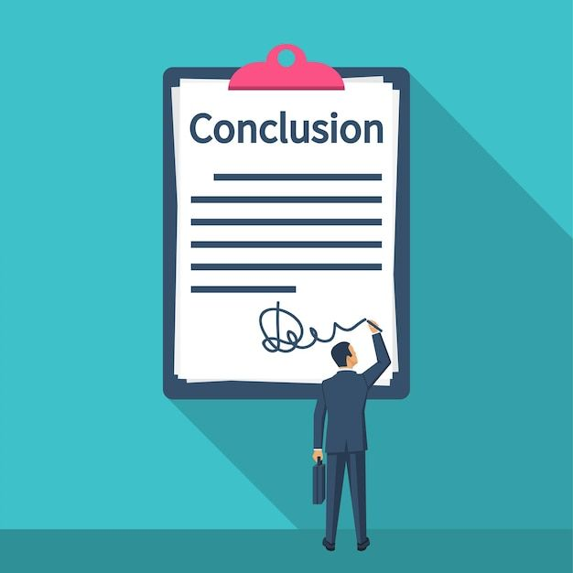
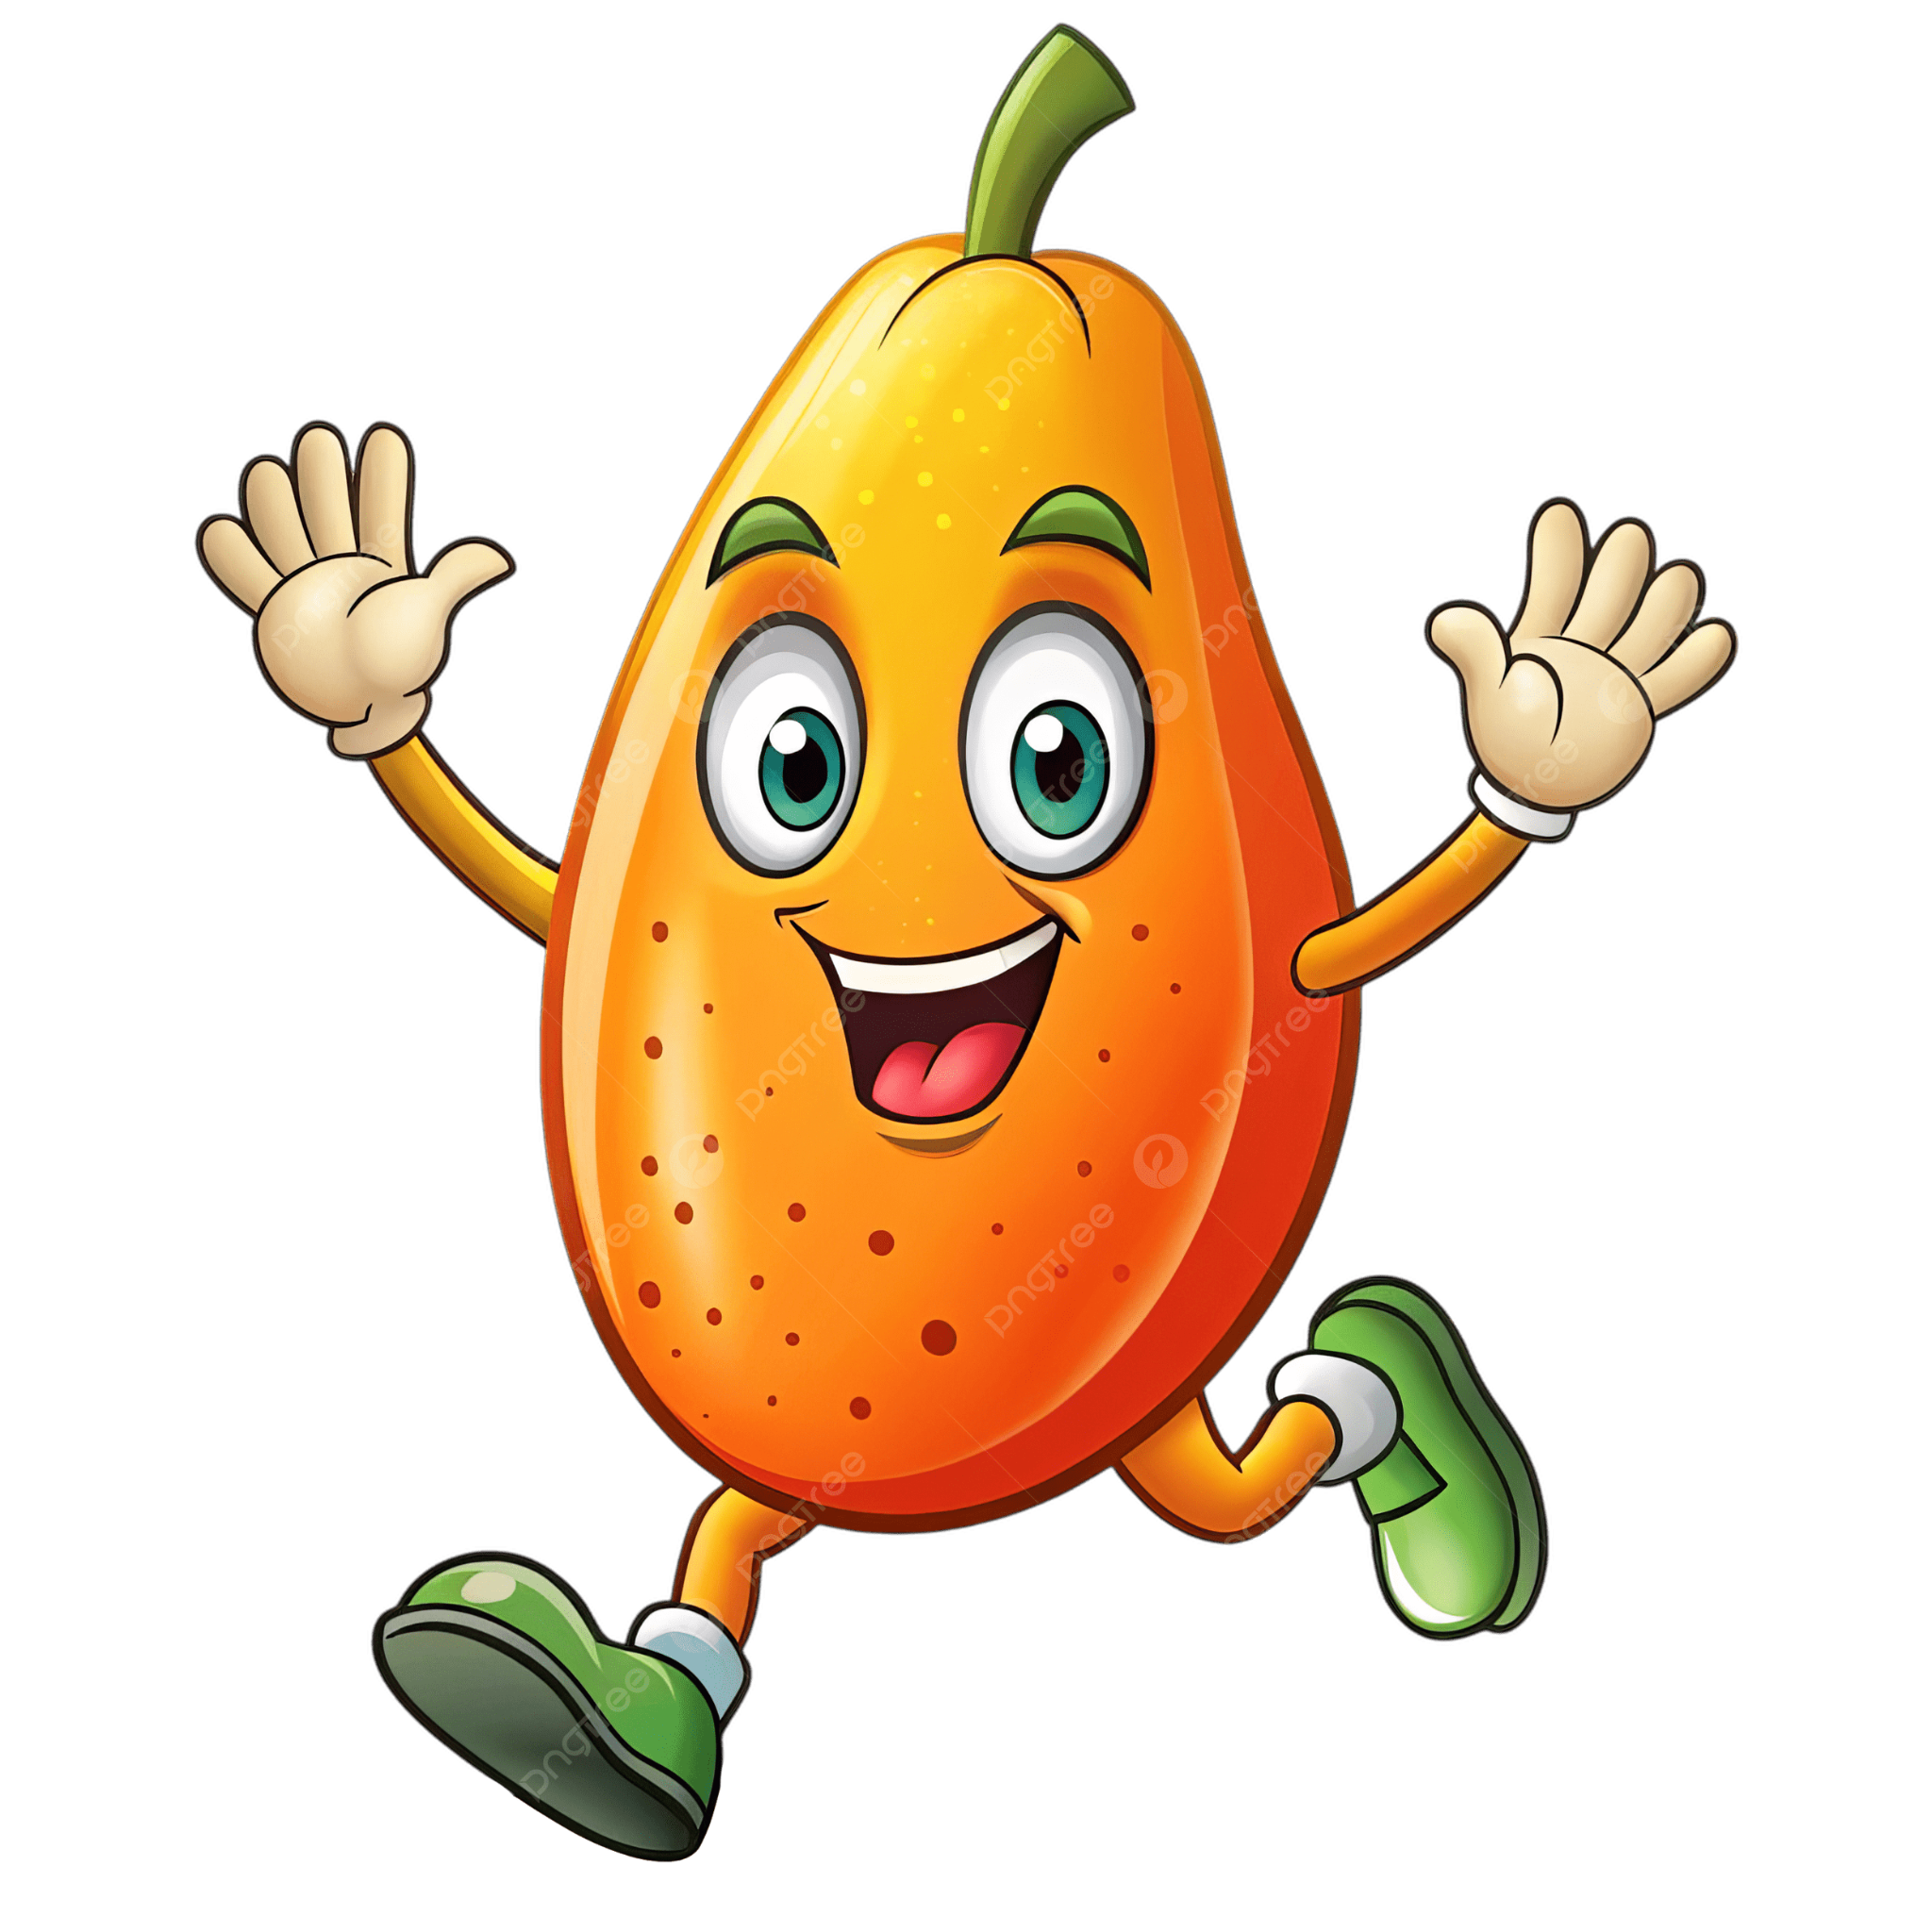
Summary
Clear structure, colored barriers, and balanced layout allow different audiences to quickly see what leads to danger and how harm can be reduced.
Visual storytelling is not just about accuracy it is about clarity, focus, and supporting better decision-making.
The Bowtie diagram helps make complex commercial vehicle risks easy to understand at a glance.

Slide 8
Ask us anything!

